Slide 1

C# Web Development Basics
Course Introduction
SoftUni Team
Technical Trainers
Software University
http://softuni.bg

Slide 2
Table of Content
C# Web Development Basics
Course Objectives
Program
The Module Team
Evaluation
Project Defense

Slide 3













SoftUni Diamond Partners

Slide 4





SoftUni Organizational Partners

Slide 5
Questions
sli.do #csharp-web

Slide 6

C# MVC Frameworks
Course Objectives & Program

Slide 7
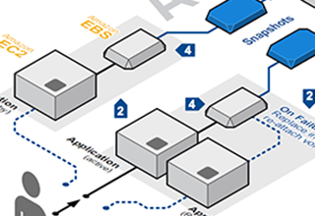
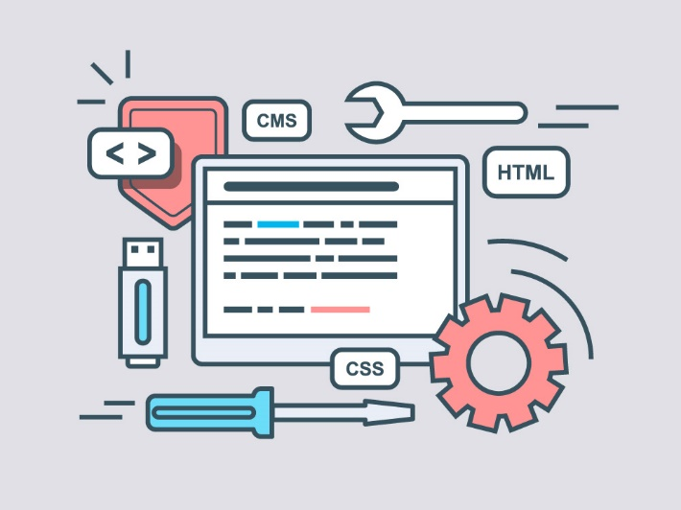
Course Objectives
The C# MVC Frameworks course provides
In-depth knowledge in the ASP.NET Core Framework
Knowledge for creating RESTful services
Architectural design
Best practices in modern ASP.NET Core applications
Deployment

Slide 8



C# Web Dev Basics – Course Program
Course Introduction – Course Program, Trainers, Exams, Resources
Introduction to ASP.NET Core
Introduction to Razor – Views & Layouts
Application Flow, Filters & Middleware
Working with Data – Data Binding, Validation etc.
Security & Identity
Advanced Topics

Slide 9



C# Web Dev Basics– Course Program (2)
Advanced Topics: Architecture
Testing
Deployment & Continuous Integration
Web API & JWT
Razor Pages
SignalR
Blazor

Slide 10


The Module Team

Slide 11
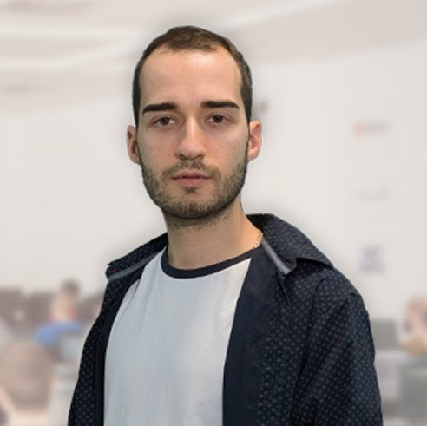
Module Team (Trainers)
Nikolay Kostov
Solutions Architect @ ZenCodeo
15+ years in the IT
Developer, Manager, Trainer, Architect
Аctive role in the development of the Judge platform - https://judge.softuni.bg/
Microsoft Certified Trainer
Personal blog: nikolay.it

Slide 12
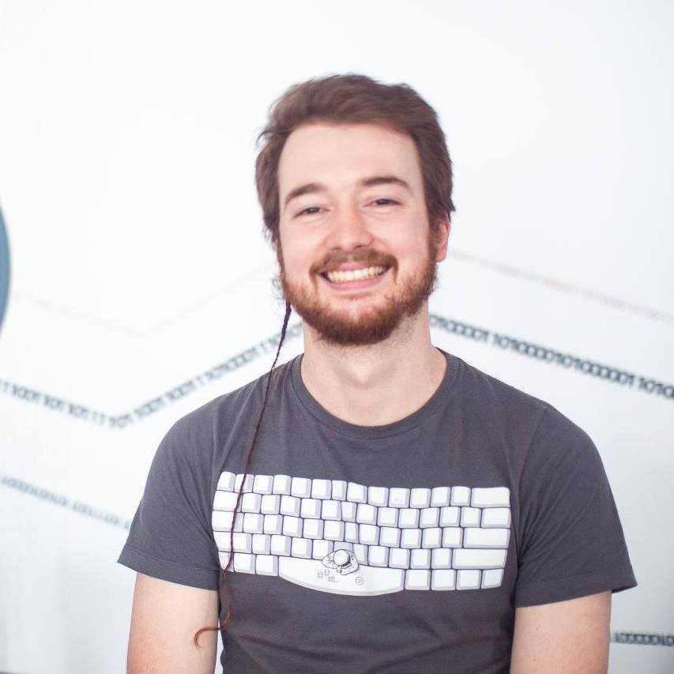
Module Team (Trainers)
Svetlin Galov
Full-Stack Web Developer @ SoftUni
3+ years in the IT
Top performing student of SoftUni
A passionate .NET Guru

Slide 13
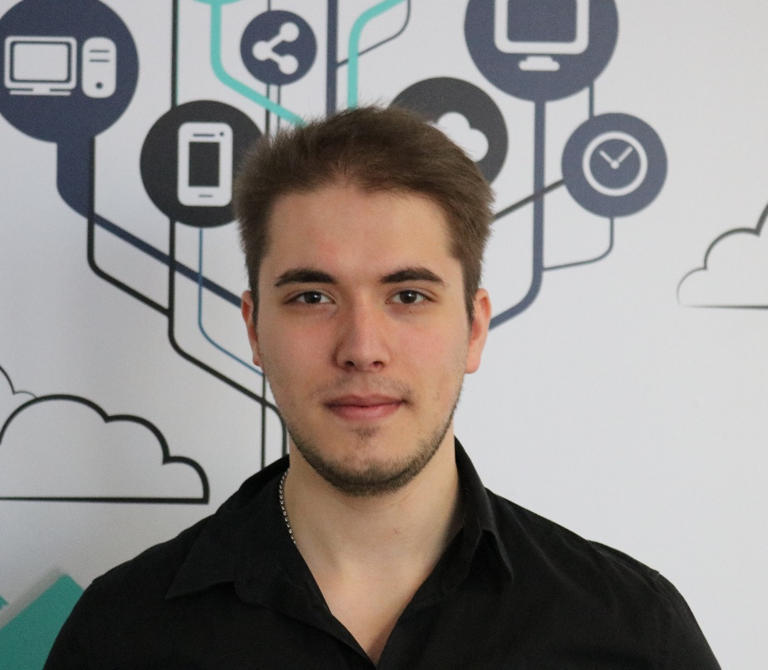
Module Team (Materials & Resources)
Ivaylo Jelev
Training Team Leader @ SoftUni
5+ years in the IT
3+ years as a Technical Trainer @ SoftUni
Professional Problem Creator (Exam & Exercise Problems)
Interested in Game Development

Slide 14

Module Team (Materials & Resources)
Mirela Damyanova
Training Assistant @ SoftUni
Graduated Student from SoftUni
Loves helping students
Interested in Blockchain & Algorithms

Slide 15

C# MVC Frameworks: More Details
Duration, Schedule, Languages, etc.

Slide 16


Training Duration – C# MVC Frameworks
Lessons: ~50 hours (onsite + videos)
Practical exercises (in class): ~60 hours
Project Development: 500 hours (at least)
Schedule: November 2018 – January 2019
Exam date: 06 January 2019
Second exam date: 10 January 2019

Slide 17



Learn to Search in Internet & Find Solutions!
The course assignments require to search in Internet
This is an important part of the learning process
Some exercises intentionally have no hints
Learn to find solutions!
Software development includes everyday searching and learning
No excuses, just learn to study!
Developers learn new technologies, tools, languages every day!

Slide 18

C# MVC Frameworks
Evaluation Criteria

Slide 19


Scoring System for “C# Web Dev Basics”
Individual Project – 90%
Homework (exercises) – 10%
Bonuses – up to 10%
Presence in class: 5% (onsite students only)
Forum activities
Others

Slide 20

Homework Assignments
Doing your homework is very important!
Programming can only be learned through a lot of practice!
You should write code every day!
Each lesson is followed by many exercises
Try to solve them in class
The rest are your homework
Homework assignments are due in 6 days after each lecture
Submission are sent on the course page at softuni.bg

Slide 21

Resources
Resources
What We Need Additionally?

Slide 22


Your RFID Chip
Students can either
Take RFID chip from SoftUni
Or use their own chip / card
Register your chip number in your SoftUni profile: https://softuni.bg/users/profile/show
Check-in at the reception every time when you come
See your last visits in your profile: https://softuni.bg/users/profile/show

Slide 23



C# MVC Frameworks Course Page, Forum and FB Group
Official web site:
Official discussion forum:
Official Facebook groups:
https://softuni.bg/courses/asp-net-mvc
https://softuni.bg/forum/categories/31/csharp-mvc-frameworks-asp-net
https://www.facebook.com/

Slide 24



The C# Web Slides and Videos
All lecture slides, videos, homework assignments, projects and other resources are open content, available for free
Visit the course web site to access the course resources

Slide 25

Software University Learning System (SULS)
Software University Learning System (SULS)
www.softuni.bg
Important resource for students
Homework submissions
Homework check-up
Exams and results
Reports about your progress
…

Slide 26


Required Software
Software needed for this course:
Microsoft Windows (Win 10 / 8.1 / Win8 / Win7) or Mac or Linux
Visual Studio 2017

Slide 27

Summary
…
…
…
Training Program
Training Team
Individual Project
Description & Requirements
Learning resources
Slides, videos, software, books, forum

Slide 28
https://softuni.bg/trainings/courses

Slide 29




Trainings @ Software University (SoftUni)
Software University – High-Quality Education and Employment Opportunities
softuni.bg
Software University Foundation
http://softuni.foundation/
Software University @ Facebook
facebook.com/SoftwareUniversity
Software University Forums
forum.softuni.bg

Slide 30

License
This course (slides, examples, demos, videos, homework, etc.) is licensed under the "Creative Commons Attribution-NonCommercial-ShareAlike 4.0 International" license

